Slide 1
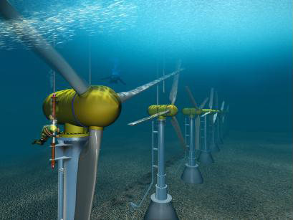
Generating Power for Remote Applications in Extreme Environments
Nathan Rich
Supervisor: Pat Bodger
Acknowledgements: Bill Heffernan and Alan Wood

Slide 2
Aim
This project intends to find a novel way of powering a device without the use of battery power

Slide 3
Specific Aims
Choose an application to power
Find a way to generate power from the application’s environment
Design a device to generate and use this power

Slide 4
Application

